Slide 1
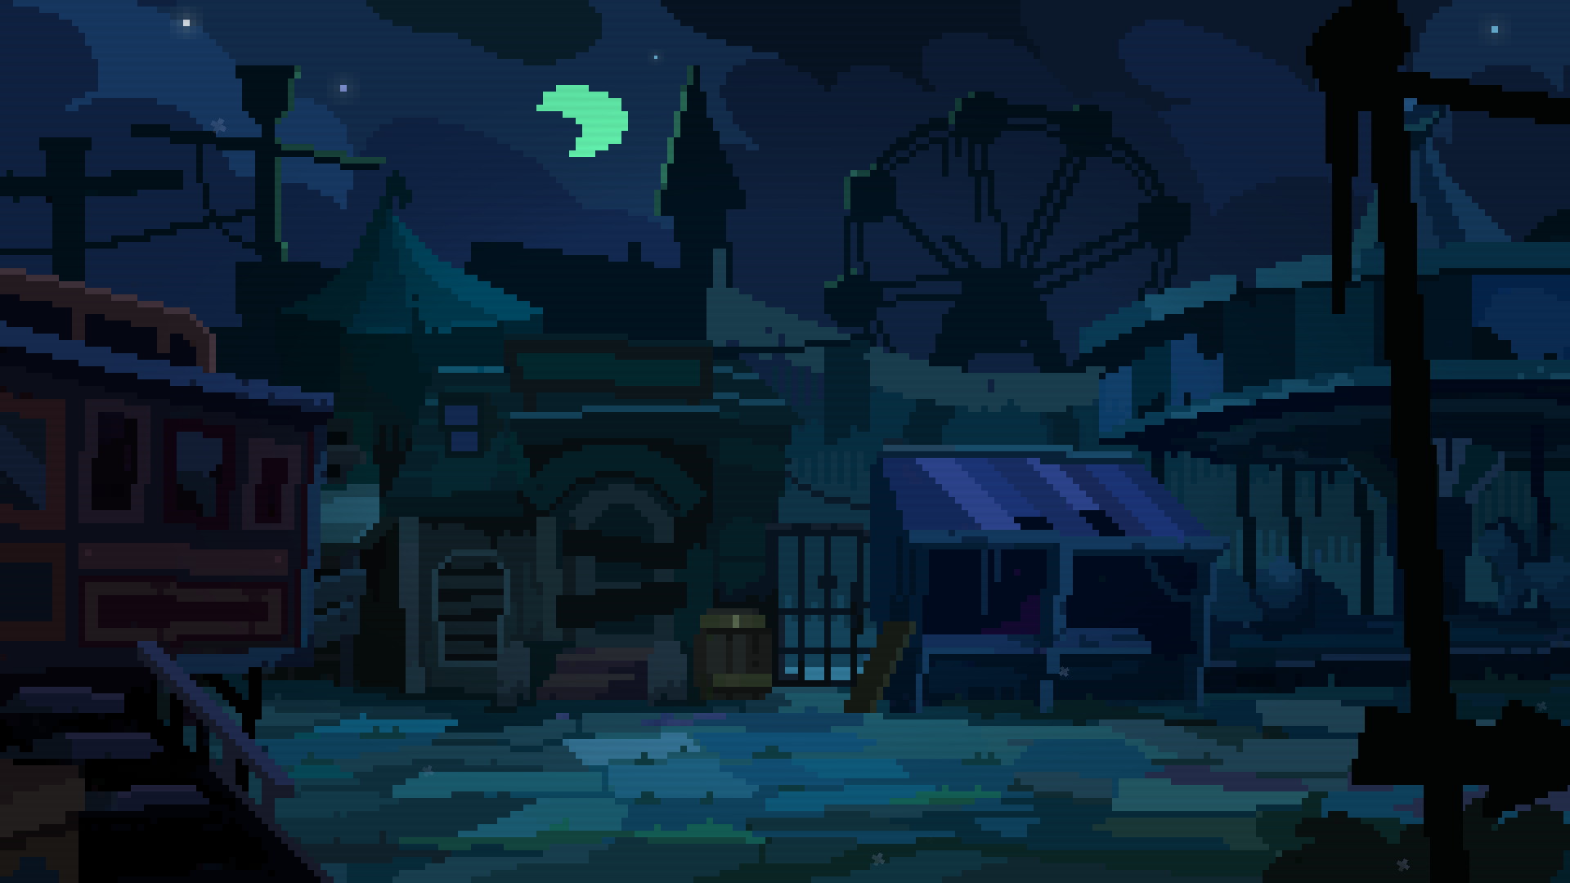

When hell runs a horror ride, no one is safe.
By Indiesruption

Slide 2


Overview
A 2D procedural roguelite adventure with permadeath, dark humor, missing celebrities, ridiculous monsters and hundreds of items.
Two mediocre journalists against a demon-possessed horror ride. Every place is a ticking time bomb, every monster a cruel joke, and every cart you push is your only shot at escape.

Slide 3

Specifications
Genre: 2D roguelite adventure.
Graphic style: Pixel-art / 2.5D.
Rating: Adult language, some blood.
Audience: roguelike players and indie fans, 13+ years old.
Development Platform: MonoGame/C#

Slide 4
The Horror Ride
Back in its glory days, Snuggleville Amusement Park wanted to add a new attraction. The answer was Remizione, a horror ride designed to drag visitors through a delirious journey into the torments of purgatory.
The project was handed to William Boo, a ride designer notorious for his unhealthy obsession with terrifying dolls.
The result was a ride as grotesque as it was mesmerizing: a mechanical parade of sins, animatronics, canned screams, and smoke-scented junk that sparked more nervous laughter than joy.
Then a demon moved in and—bam—suddenly the ride wasn’t a ride anymore. It was purgatory with bad hydraulics.

Slide 5
Background Story (1/3)
The Mystery of Snuggleville
In Snuggleville, a town famous for gossip and its amusement park, everything was laughter and cotton candy. At least, until the grand opening of Remizione, a horror ride so ambitious its creator was a deranged obsessive who even kept track of the puppets’ warts. For the premiere, they invited the 12 most “important” personalities of the town. They boarded smiling, of course. Did they come back? Not a chance. The creator? Gone too. The park, turned into a cursed meme and went bankrupt faster than a politician’s morals.

Slide 6
Background Story (2/3)
The Most Unlikely Heroes
Many years later, twins Edmundo and Berta Idle, editors of Mysterious Mysteries magazine, decide to investigate the case. Their plan: sneak into the abandoned park at night, armed with more enthusiasm than brains and dreaming of a Pulitzer Prize.
What they don’t know is that the attraction is now home to Mandinga, a frustrated demon who, as a child, dreamed of having his very own horror ride—and isn’t about to give it up.

Slide 7

Background Story (3/3)
A Journey Bound to Go Wrong
On a night full of absurd scares and very real danger, the Idle twins face a challenge way beyond their league.
Will the twins manage to become the town’s heroes? Or will they end up trapped forever with the others?
One thing is certain: what they’re about to experience is a monumental stupidity.

Slide 8
Gameplay (1/2)
Explore an evil horror ride filled with ugly creatures, traps, puzzles, items and secrets.
Simple 2D bizarre action. Push carts and face grotesque monsters and bosses.
Permadeath: each death teaches something new and unlocks items.
Unlocks are diverse and surprising: players can earn new content by defeating bosses, surviving a set number of runs, discovering secret areas, or completing bizarre hidden tasks.

Slide 9
Gameplay (2/2)
Loot-Creatures spits out items and energy to power each exit cart; your choices shape survival.
Choose which twin to use—each with unique traits. Some areas of the attraction can only be unlocked by a specific character.
Find the ride’s deranged designer to unlock the abandoned park’s ATM, where your hard-earned tickets turn into points to buy unique items and hidden areas of the attraction.

Slide 10
Gameplay (3/3)
Inventory growth is permanent: expand your slots by stitching them with needles and thread found during runs—once unlocked, they never shrink back.
Meta-objectives: Rescue twisted parodies of real-world celebrities—each with a ridiculous name and a bizarre quirk that mocks their persona. For example, Bill Doors might give you a tip for the ATM, only to trigger a Windows-style “blue screen of death” error.

Slide 11
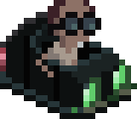
Core Loop
Choose
character
Unlock
new stuff
Begin
ride
Survive ride

Slide 12

Key Features (1/2)
Unique art and humor blending the grotesque with the comedic.
Procedurally generated levels making every run unpredictable.
Bizarre creatures and items. Everyday amenities—like toilets and kiosks—remain in use inside the attraction.
Earn tickets and exchange them for strange but useful souvenirs.
’90s-style MIDI-inspired soundtrack combining jazz, lounge, and retro adventure vibes to match the humor and chaos of the game.

Slide 13
Key Features (2/2)
Risk/reward mechanics (optional bosses, secret rooms).
Atmospheric 2D lighting — sometimes only your items can pierce it.
Encounter a cast of bizarre characters, from Mandinga—the demon that hijacked the ghost train—to his assistant Sister Ham, and countless other oddballs populating the ride.
Narrative twist with meta-goals to bring layers of mystery and long-term goals.
Break dungeon gates with your items, run after run, until you finally face the boss and rescue a lost celebrity.

Slide 14
Inventory
Junk: Odd gadgets you can equip to whack, poke, or do something questionably useful.
Consumables: Eat or drink anything: from healing snacks to chili-powered speed boosts.
Key items: Scene-specific tools for interacting with the environment: pick locks, operate machines, use kiosks, trigger devices.
Trinkets: Passive oddities with quirky powers. One at a time, so choose your curse wisely.
Perks & Flaws: Temporary and fixed states that twist your run and force players to adapt on the fly—sometimes (e.g., Overeat fast food and you might end up gassy, pausing mid-fight to clutch your stomach.)

Slide 15
Look & Feel

Slide 19
Lighting system

Slide 25
Current Status
Proprietary engine ready - developed in C# with MonoGame has its own scripting language and has proven its robustness and efficiency across 3 shipped titles for PC and consoles.
Core gameplay loop defined and partially playable in prototype form.
Procedural level generation implemented and stable and ready to be loaded with a ton of art.
Inventory management functional.
Visual identity and bizarre humor strongly established.

Slide 26
Needs
Funding to create the adventure and the huge content of assets (items, characters, monsters and a variety of assets for the procedural environments.)
Marketing and publishing + trailers production.
Professional translations.
Console porting (if needed): We don’t handle this area, but our code is 100% AOT compatible to ensure smooth and efficient transition for potential platform development. All our three games were successfully ported to al major consoles.

Slide 27

Future Growth
The game world can smoothly expand over time with DLCs, new creatures, places, items, and ever-changing procedural content.

Slide 28
Who We Are
Veteran indie developers with 30+ years of industry experience.
Published 3 games on PC and all major consoles (PlayStation, Xbox, Switch). All with the same publisher, proving both trust in our work and our reliability as long-term partners.
Our games have earned multiple awards, recognized for creativity and originality.
Passion-driven team focused on delivering unique, and unforgettable experiences.

Slide 29
Production
Development time: 14 months.
Development cost with recoup: xxxK U$S (*)
Lead designers (2)
Programmer
Writer
Background artist
2D Animator
Original soundtrack
(*) Does not include trailer production, translations and console porting.

Slide 30
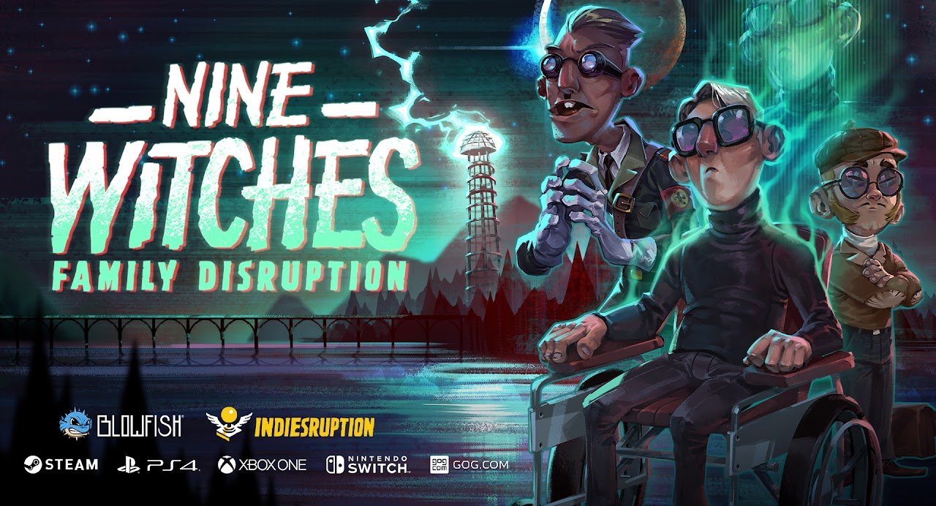
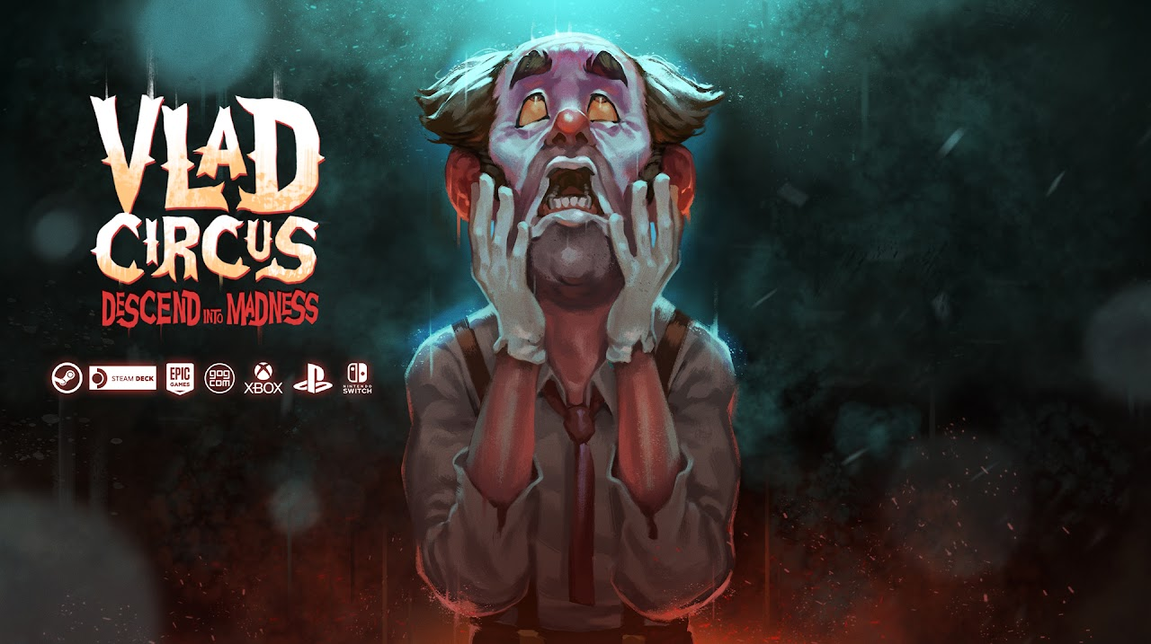
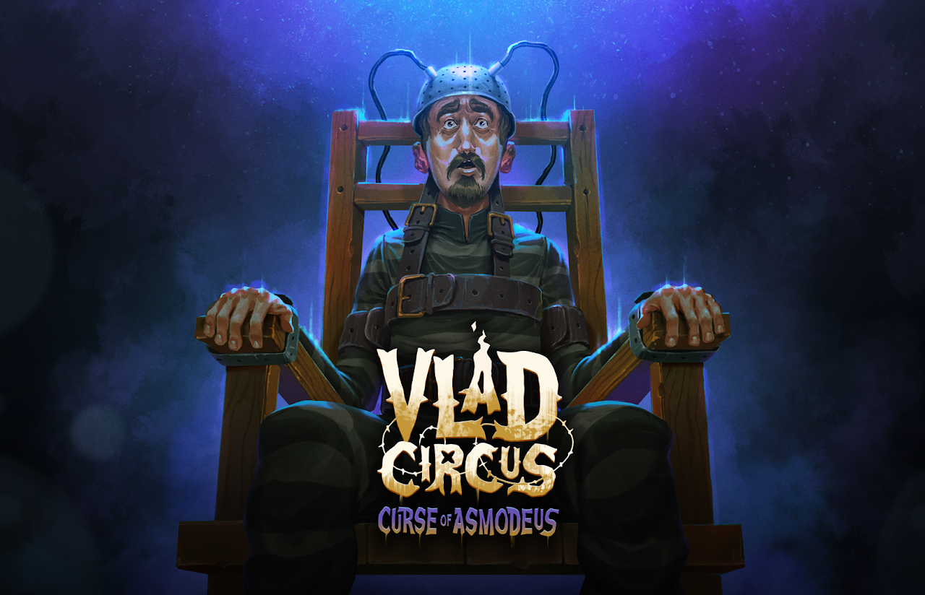
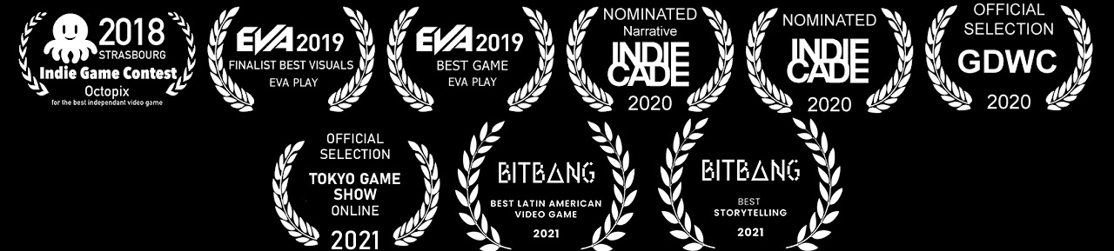
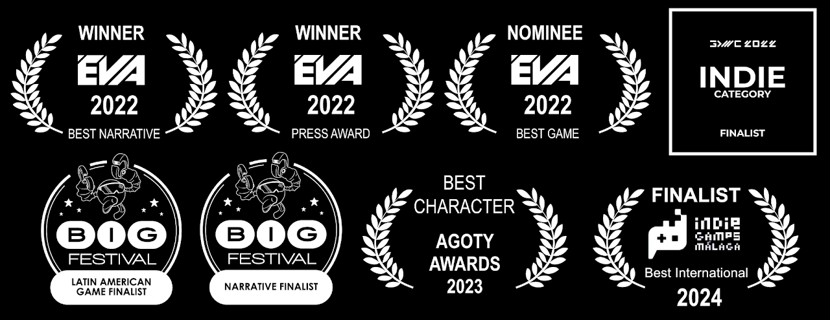
Our Games

Slide 31

Thanks!
indiesruption.com

